Slide 1

MOVIE PLEX THEATRE
MOVIE PLEX
THEATRE
Final Group project
Gurminder Singh,
Bikramjit Singh Khokhar,
Rashid Gundlour Mahamed,
Gurmanpreet kaur Grewal,
Dilpreet kaur

Slide 2
Introduction Movie plex is a fully automated ticket selling system where one can buy tickets online. This application has two users: 1. Administrator 2. Guest

Slide 3
Landing page A user is presented with two options -1 for Admin panel and 2 for Guest panel. If a user enters any character or a digit except 1 or 2, he will be prompted with an error message and will be able to select option again within few seconds.

Slide 4
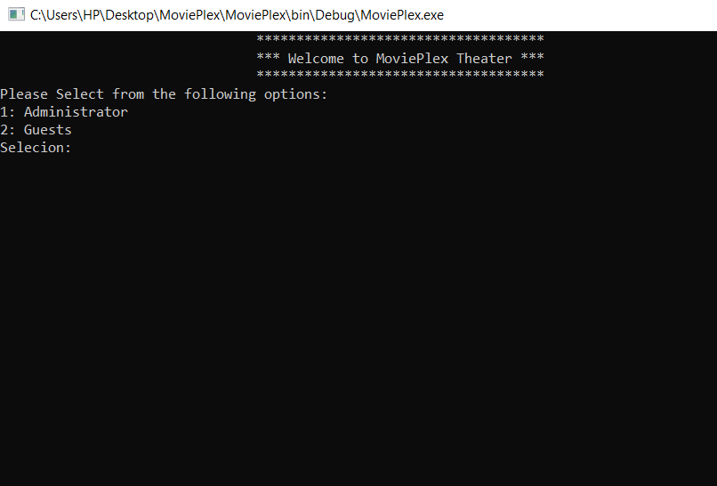
Landing Page

Slide 5
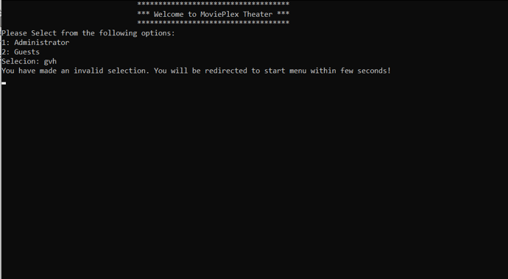

Slide 6
Landing page On Select 1, user will be asked for admin password. There are only 5 attempts for user to enter correct password. If user enters letter ‘b’ or ‘B’, he will be redirected to start of application. If user enters correct password, admin panel will be opened.

Slide 7
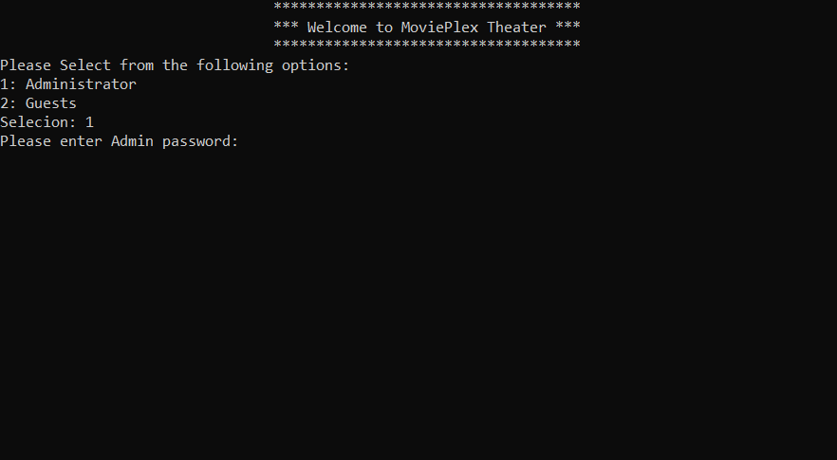

Slide 8
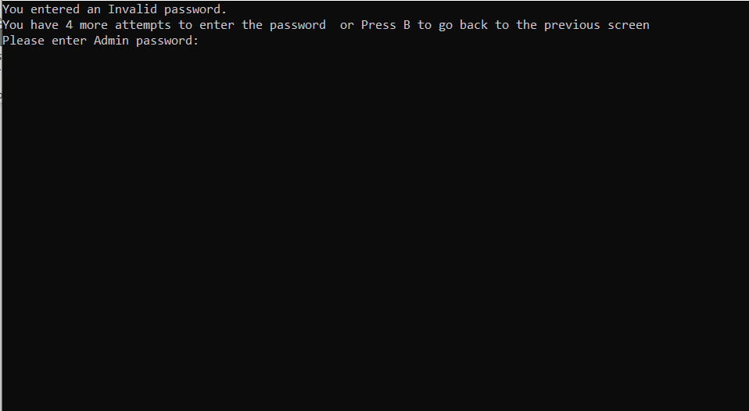

Slide 9
Administrator On admin screen, an admin has the responsibility to enter the number of movies to be played for a particular day. He would enter the movie name and age rating for specific movie. There is a privilege for an admin to re-enter the movies to be played on that day in case he is not satisfied with the earlier entered movies.

Slide 10
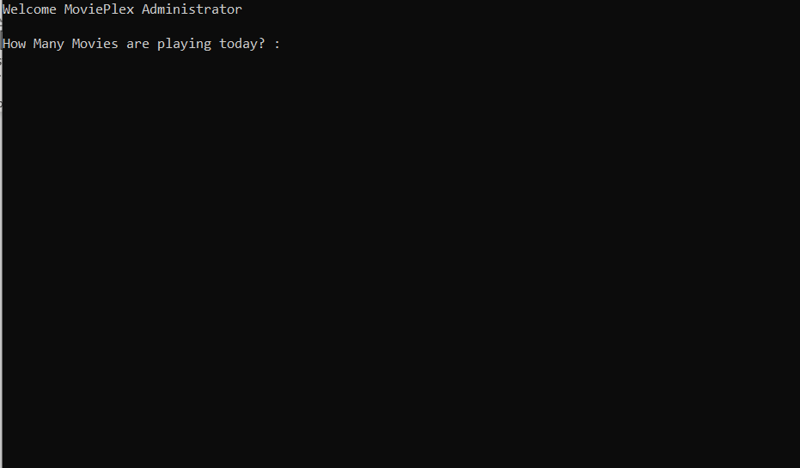
Admin Panel

Slide 11
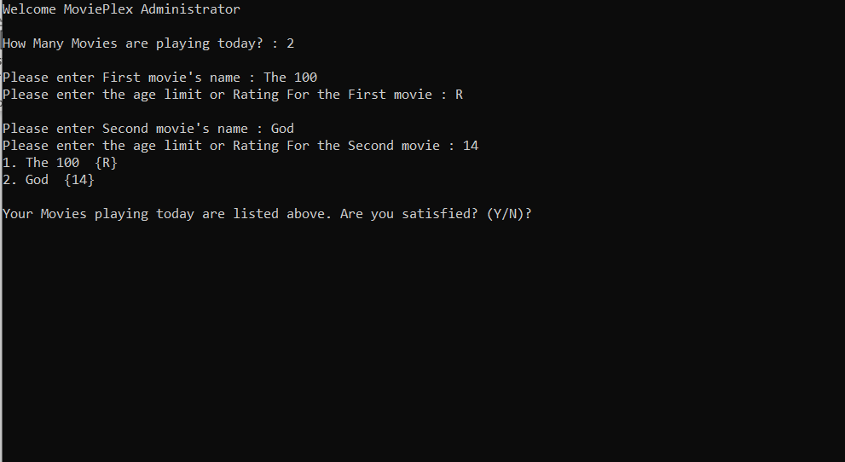

Slide 12
Guest On guest screen, list of movies being streamed on that day will be displayed. Here, guest will give his/her choice of movies and then guest needs to enter his/her age for verification.

Slide 13
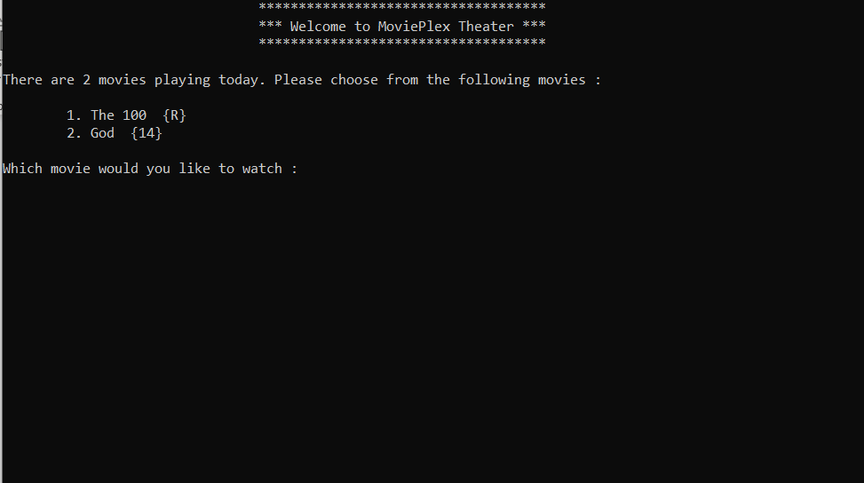
Guest Panel

Slide 14
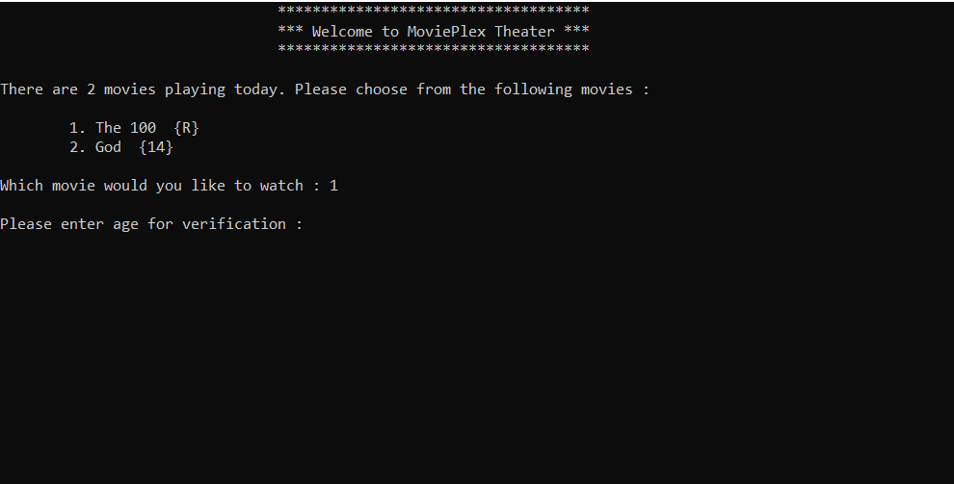

Slide 15
Rating chart G - General Audience, any age is good PG – We will take PG as 10 years or older PG-13 – We will take PG-13 as 13 years or older R – We will take R as 15 years or older. Don’t worry about accompany by parent case. NC-17 – We will take NC-17 as 17 years or older.

Slide 16
Guest If user enters invalid age such as any character, negative value etc., he will be prompted with error message either ”age should not be negative Please enter age between 1 and 120 or “Invalid Age!” If it finds, entered age is apt for selected movie then a message will be displayed as “enjoy the movie!”, else, user will be prompted with message that he is not allowed to watch this movie.

Slide 17
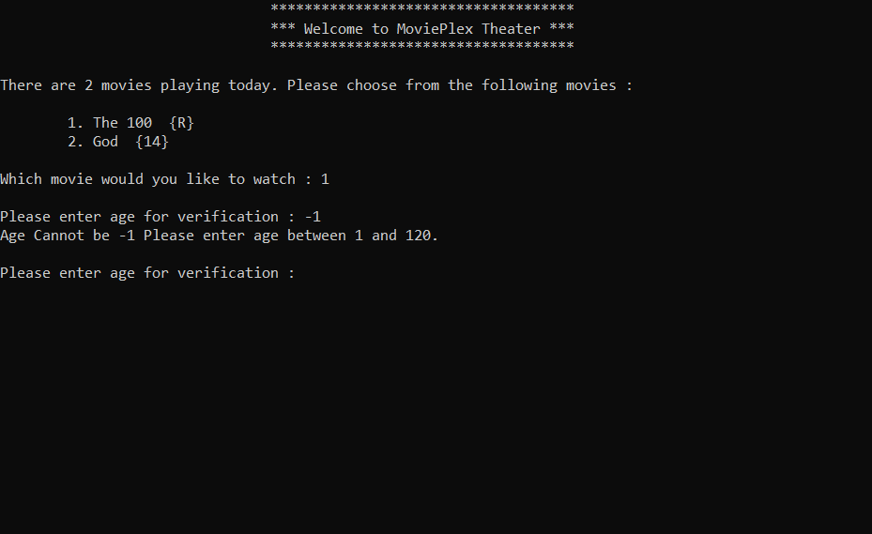

Slide 18
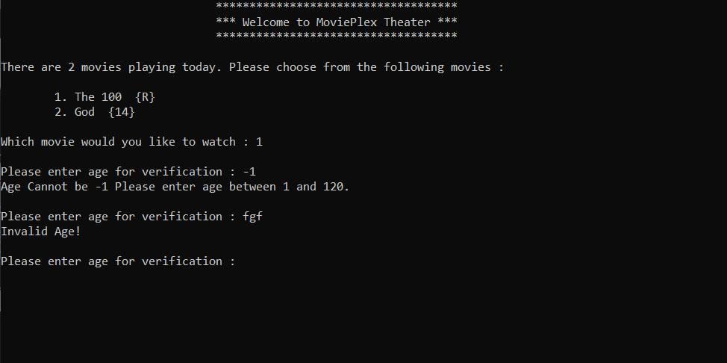

Slide 19
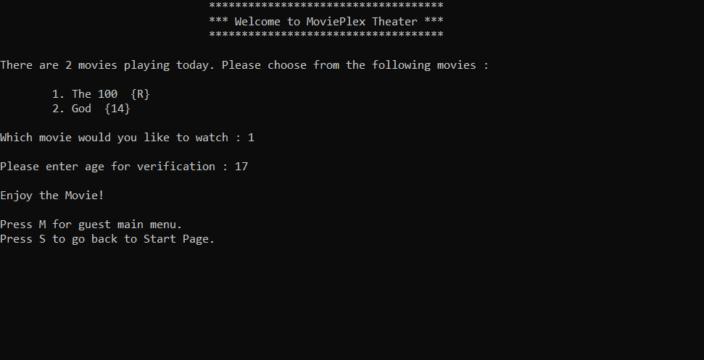

Slide 20
Guest Also, user has a privilege to make another movie choice by pressing ‘M’ or get back to landing page by pressing ‘S’

Slide 21
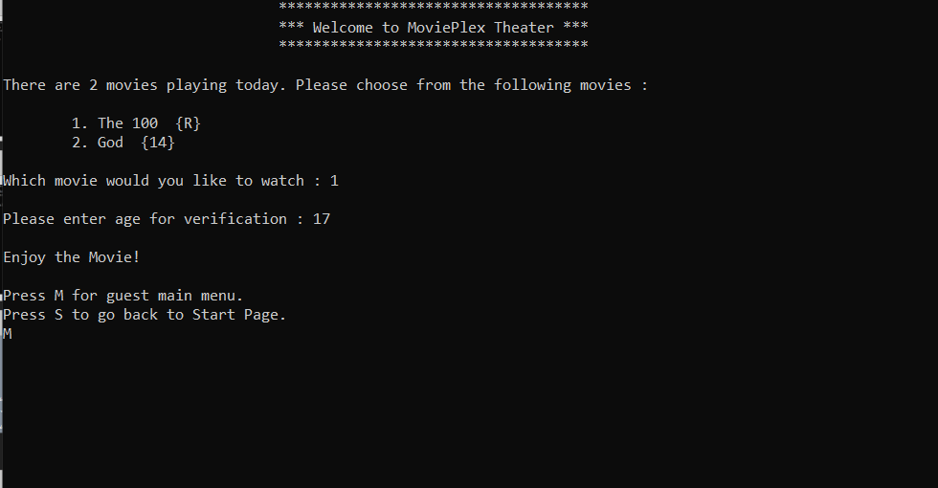

Slide 22
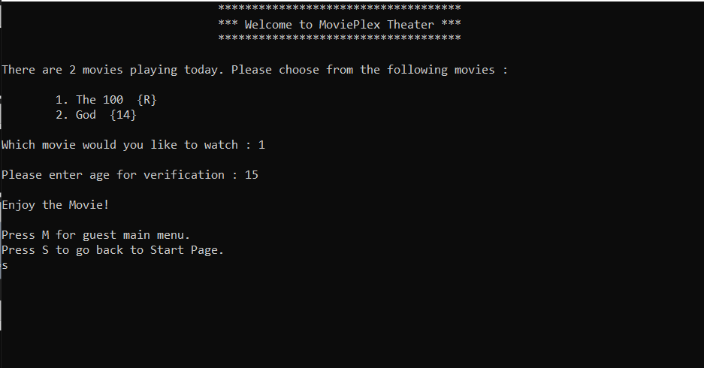

Slide 23
Thanks

